Slide 1

Student Exame Admin management system

Slide 2
Introduction
The student exam management system can be implemented using data structures such as Queue, Stack, Linkedlist, trees and etc.
We implemented a student exam management system using a queue data structure. The student queue in line based on their participate time.
The one who participates first is treated first. User can easily handle the management system by using there functions what the system provides.
This student exam management system can efficiently store, retrieve, and manipulate the information.

Slide 3
Functions
1. Add New Student.
2. Delete Student.
3. Display Next Student.
4. Search Student.
5. Display Relevant Student is for which Subject.
6. Display Highest Marks for Science and Math.
7. Display Lowest Marks for Science and Math.
8. Display Total Number of Students.
9. Display whose not attend to exam.
10. Display Lowest Marks Student for Math and Science.
11. Display Highest Marks of Student for Math and Science.
12. Login and Authentication.

Slide 4
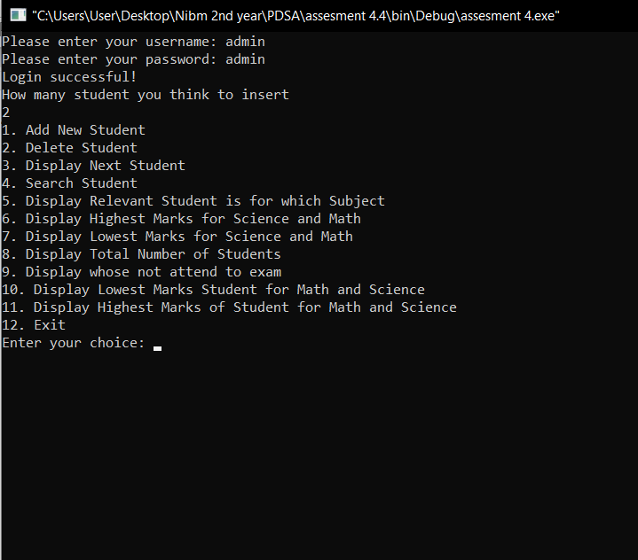
User Interface
We used the command prompt as the user interface for admin's works.

Slide 5

Thank You.

